Slide 1

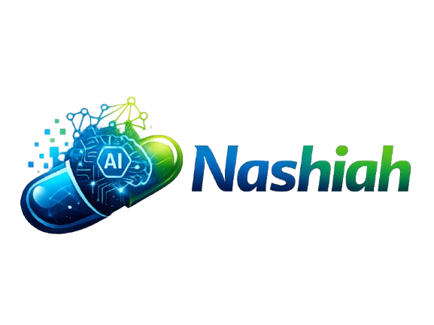
NASHIAH
AI Agency Platform - Pharma Commercial Agentic Workforce
A strategic technology partnership for scalable, compliant execution

Slide 2

A division of ISmile Technologies for Pharma, Healthcare and Lifesciences
A technology and delivery partner that helps pharma commercial teams, marketing agencies execute client work faster, expand their capabilities, and build recurring revenue.
Agency need | What Nashiah delivers
AI-enabled services | Build agents that generate content, commercial insights, and next best action recommendations with human oversight.
Produce and launch digital campaigns | Develop websites, landing pages, emails, banners, and interactive visual aids from agency-approved creative.
Keep client digital properties running | Manage hosting, monitoring, security maintenance, and timely approved-content updates.
Simplify brand performance reporting | Connect media, web analytics, and CRM data into brand-specific data lakes and automate recurring reports
Nashiah helps pharma marketing agencies turn creative ideas into digital experiences, connected intelligence, and AI-enabled services giving them more delivery capacity and new services to sell to their clients.
The agency owns the client relationship, strategy, and creative direction. Nashiah provides the technology, engineering, data, and ongoing operations that bring those ideas to life.

Slide 3





Nashiah : Strategic Technology Partner with Product Mindset
Data Platform, Machine Learning & AI Insights
AI Applications & Innovation
•
•
Commercial Data lake setup
Added Value
Transforming services to products using AI workflows, Agents
•
Data lake + analytics
•
Custom AI dev (Cloud+ AI)
•
ML – powered MTA, MM, Markov 100+ data source connectors built
•
AI-enabled Pre-MLR review
Faster time-to-market
•
AI audience simulation (HCP/Patient)
•
Automated Media, Campaign performance reporting
AI-driven innovation and automation
•
AI Workflow automation & rapid prototyping
•
HCP vs DTC analytics
Unified data and marketing intelligence
•
AI & ML - powered reach and frequency forecasting
•
Natural language querying
Seamless omnichannel orchestration
Integrated Development
Omnichannel Orchestration
•
AI enabled digital assets production with compliance
•
Automated cross channel deployment/activation of assets (emails, approved content etc)
•
Modular & reusable frameworks
•
Modular content dev (emails, banners, sites)
•
MarTech stack enabling commercial sales operations teams
•
Rapid build & deployment cycles
•
Setup/Configuration/Integration of MarTech Stack
•
Full-stack , CMS development
•
Journey Orchestration & Automation
•
Automated tagging & metadata
•
AI-Powered Next Best Actions
•
Alignment with Regulatory workflows
•
Taxonomy & standardization

Slide 4




Nashiah: Strategic Technology Partner with Product Mindset
Hosting, Infra & Managed Services
Technology Leadership
•
Secure, scalable website hosting (AWS/Azure/GCP etc )
•
Fractional CTO leadership
•
Cross-functional alignment across teams
Added Value
•
Performance optimization
•
Compliance-ready environments
•
Technology roadmap planning
•
Governance & delivery oversight
Scalable hosting and managed services
•
Monthly managed services for digital assets
•
Alignment with business & revenue goals
•
24x7x365 support & maintenance teams
24/7 operational support
Fully compliant
QA & Validation Testing
Veeva Platform Enablement
•
Content classification (claims, MLR)
•
Improved searchability
•
Veeva PromoMats (content lifecycle)
•
•
Veeva CRM (engagement/field)
Email campaign testing
Banner/display ad testing
Website and microsite testing
Mobile/device/browser compatibility
Accessibility (WCAG)/Analytics validation
Defect management/Pre-launch and post-launch support
•
•
Veeva Compass (data)
•
•
Veeva Claims (MLR-compliant)
•
•
Veeva Network (MDM)
•
•
CRM Migration & Optimization
•
An integrated capability stack starting with AI innovation and data intelligence, executed through development and orchestration, and supported by scalable infrastructure and managed services.

Slide 5
1 Commercial Growth & Customer Engagement
◆
Commercial Strategy & Launch Excellence
▣
CRM, Sales & Commercial Operations
↗
Launch planning and commercial readiness
Portfolio, brand and market strategy
Forecasting and performance measurement
Field-force and incentive compensation design
Close the gap between CRM activity and P&L impact
Modernize Veeva and Salesforce-enabled workflows
Connect planning, insight and field action
Improve governance, adoption and execution
Business Value
Faster, more confident launch decisions
Higher value from CRM investments
More coordinated HCP engagement
Clearer commercial performance visibility
↔
Omnichannel HCP Engagement
●
Commercial Analytics & Insights
Coordinate HCP journeys across channels
Improve channel, audience and content decisions
Connect engagement signals to next actions
Create consistent customer experiences
Unify fragmented commercial data
Move from reporting to decision support
Measure campaign and field effectiveness
Turn market research into a real-time sensing engine
From fragmented commercial activity to connected execution
Notes:
Based on references in your enterprise data, plus multiple ZS-sponsored pharma thought leadership pieces appearing in your industry feeds, ZS is positioning itself around several core pharmaceutical business problems:
1. Commercial Analytics & Decision-Making
ZS helps pharma companies turn fragmented commercial data into actionable decisions by connecting CRM, engagement, marketing, sales, and field data and improving commercial performance measurement. This includes helping clients move from dashboards to measurable business impact. turn2search42
Problem solved:
Too many dashboards, not enough decisions
Difficulty linking onichannel engagement to revenue and prescribing outcomes
Poor visibility into commercial performance
2. Omnichannel & HCP Engagement
ZS focuses heavily on HCP and patient engagement, helping commercial teams determine:
Who to engage
When to engage
Through which channel
With what content
This aligns with omnichannel orchestration and commercial transformation offerings. turn2search32
Problem solved:
Fragmented customer journeys
Inconsistent HCP experiences
Lo marketing effectiveness
Channel coordination challenges
3. CRM Optimization & Commercial Operations
ZS promotes improving value from CRM investments and commercial platforms rather than simply deploying technology. They specifically discuss closing the CRM value gap and improving operating models around CRM and AI. turn2search51
Problem solved:
Underutilized Veeva/Salesforce investments
Low CRM adoption
oor linkage between sales, marketing, and analytics
4. Patient & Market Access Experience
ZS discusses reducing friction between patients and care and creating more connected experiences across the healthcare ecosystem. turn2search43
Problem solved:
Patient drop-off during treatment journeys
Access and reimbursment challenges
Poor coordination across stakeholders
5. AI-Powered Commercial Transformation
ZS is investing heavily in agentic AI, commercial AI, digital labor, and AI-enabled operating models. Several references highlight AI agents supporting commercial, medical, and market access functions. turn2search52
Problem solved:
Slow decision-making
Manual commercial processes
Scaling comercial operations without adding headcount
6. Launch Excellence & Commercial Readiness
ZS frequently works with pharma clients on launch planning, commercial readiness, forecasting, targeting, analytics, and executing launches at scale. This overlaps heavily with your Nashiah positioning. turn2search77
Problem solved:
Brand launch planning
Market readiness
Launch analytics
Comercial forecasting
Where ZS overlaps with Nashiah / ISmile
From your recent internal discussions, the biggest overlap appears to be:
ZS Focus
Nashiah / ISmile Equivalent
Commercial analytics
Commercial Intelligence Platform
Omnichannel orchestration
Agient / Omnichannel Orchestration
CRM optimization
Veeva & Salesforce services
Next-best-action
Nashiah Agent Workforce
AI-powered commercial operations
Agentic AI Workforce
Launch readiness
Launch Intelligence Accelerator
Commercial reporting & dashboards
dATaStream
Internal discussions also noted ZS as a competitor that packages commercial strategy, analytics, technology, and AI into an integrated offering/platform approach. turn2search26
My assessment: ZS is strongest in strategy, commercial consulting, launch planning field force effectiveness, CRM optimization, and commercial analytics. ISmile/Nashiah can differentiate through implementation, managed services, agentic AI execution, Veeva-native workflows, data engineering, omnichannel orchestration, and operating the technology stack after the strategy is defined. [Noha Q3 Sales Target | Teams], [SELL-Pharm...o 1 pm CST | Teams]

Slide 6
2 Patient, Market Access & Medical Enablement
+
Patient Experience & Care Connection
◎
Market Access & Stakeholder Alignment
↗
Reduce friction between patients and care
Break silos across the healthcare journey
Create connected, seamless patient experiences
Respond to AI-enabled patient expectations
Connect commercial, medical and access planning
Improve insight flow across functional teams
Support coordinated stakeholder engagement
Link market signals with business decisions
Business Value
Less friction across the care journey
Better cross-functional alignment
Scalable foundations for emerging pharma
More connected medical and access decisions
✚
Medical & Scientific Operations
⌘
Emerging Pharma Technology Roadmaps
Support evidence-led engagement models
Enable medical-field readiness with connected insights
Improve access to scientific information
Coordinate medical and commercial operating models
Design scalable, compliant technology foundations
Prioritize CRM, data, analytics and AI capabilities
Prepare operating models for agentic AI
Scale without building every capability in-house
From disconnected stakeholders to coordinated patient impact
Notes:
[Sources]
- Enterprise references: turn2search51, turn2search43, turn2search32, turn2search52.

Slide 7
3 AI, Technology & Operating-Model Transformation
AI
Agentic AI & Digital Labor
≋
Data, Analytics & Technology Modernization
↗
Shift from task automation to outcome ownership
Embed AI agents across commercial workflows
Connect planning, insight and action
Scale impact without proportional headcount growth
Build connected commercial data foundations
Modernize analytics and decision workflows
Integrate CRM, engagement and operational data
Create enterprise-ready technology roadmaps
Business Value
Faster insight-to-action cycles
Reduced manual commercial effort
Scalable AI-enabled operations
Measurable business impact from technology
✓
Operating Model & Governance
↗
Experience & Commercial Transformation
Redesign work across business and technology teams
Balance automation with human oversight
Establish governance for trusted AI adoption
Standardize repeatable commercial processes
Turn insights into measurable business action
Improve customer experiences across channels
Align AI investments with commercial outcomes
Accelerate enterprise adoption and value realization
From isolated AI tools to an AI-enabled commercial enterprise
Notes:
[Sources]
- Enterprise references: turn2search53, turn2search42, turn2search32, turn2search51.

Slide 8
ZS Focus | Nashiah / ISmile Equivalent
Commercial analytics | Commercial Intelligence Platform
Omnichannel orchestration | Agient / Omnichannel Orchestration
CRM optimization | Veeva & Salesforce services
Next-best-action | Nashiah Agent Workforce
AI-powered commercial operations | Agentic AI Workforce
Launch readiness | Launch Intelligence Accelerator
Commercial reporting & dashboards | dATaStream

Slide 9











One core. Two stacks, matched to the data.
HOW WE BUILD
Pharma Commercial use cases built for specific process and business needs
Governance, built in
AGENTIC DOMAIN STACKS (SAGE STACK + FORGE STACK)
A person approves every decision
Sage Stack
Forge Stack
Unstructured data
Structured data
Every figure traces to its source
Applications, statements, policies, narratives
Salesforce, Submittable, loan and portfolio records
Access follows each staff role
Agient Core: runs both stacks
Every action is logged
Orchestration · Guardrails · Memory · Testing · Governance
Every change is tested first
Runs in agency's cloud. Agency owns the code, data pipelines and models.
Running in production today.
Notes:
The way we do it differently from other organizations that are doing enterprise-level AI implementations is that we wrap our entire implementation around the AI core, a strong AI foundation which we call Agient Core.
Agient Core handles orchestration, guardrails, memory, testing, and governance. It's the solid system every use case is built on.
Think of it as the trust layer. That's what we mean when we say production by default. Every use case is built on that trust layer from day one.
That's why any business that needs governance and guardrails can build with us without worry.
On top of the core, we've organized our domain expertise into two stacks.
Sage Stack covers unstructured data. Think documents, videos, financial statements, policies: unorganized data. We have collected the best executions --The finetuning, delivery, precision and created reusable stack we apply to any future implementations.
Forge Stack covers structured data. CRMs and other organized data systems, like Salesforce.
Reduces the experimentation.

Slide 10











What Makes Agient Different
Most AI initiatives start with technology.
Agient starts with the workflow.
What Gets Reused
Document Intelligence
Our Approach
Workflow Orchestration
Human Approvals
1. Simplify the process
2. Remove unnecessary handoffs
3. Define approval boundaries
Audit Trails
Knowledge Retrieval
Integration Frameworks
4. Establish evidence requirements
5. Apply reusable workflow accelerators
6. Keep humans responsible for every decision
Agent Coordination Patterns
The Agient materials position these reusable foundations as accelerators that reduce implementation time while maintaining governance and control.

Slide 11
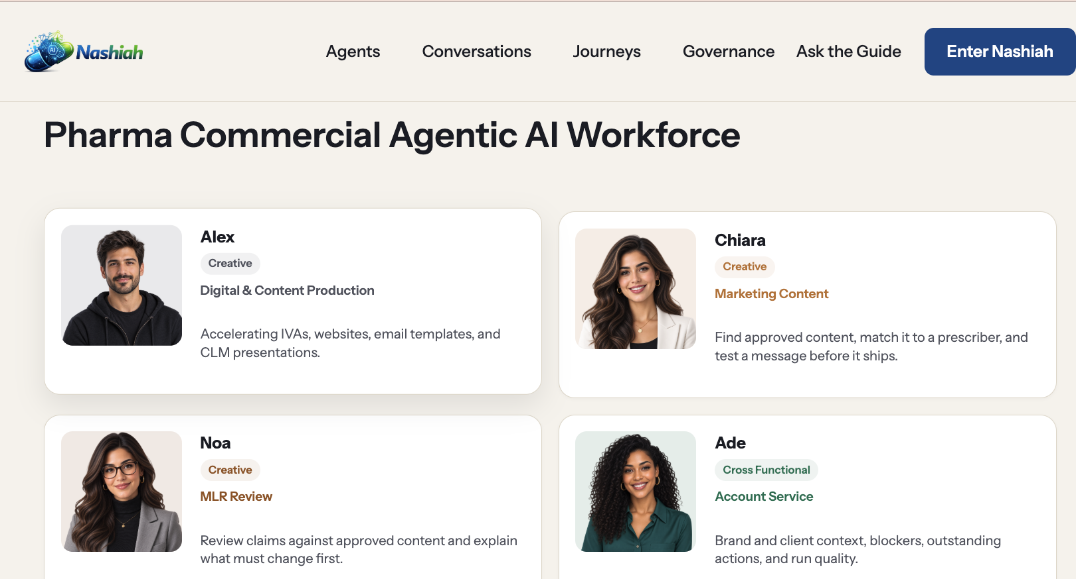

Slide 12
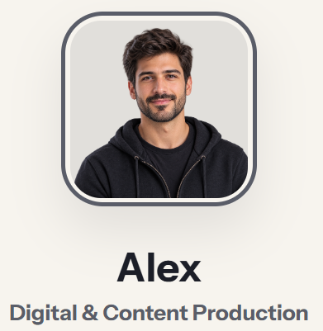
Meet Alex
✓
Digital Banners
ALEX
✓
Approved email templates
DIGITAL & CONTENT
PRODUCTION AGENT
✓
Interactive Visual Aids (IVAs)
✓
Websites & microsites
✓
CLM presentations
One specialist in the
Nashiah AI Agency Platform
✓
Pre-release validation
Nashiah | Episode 01 | Meet Alex
04
Notes:
Alex is a purpose-specific agent for digital and content production. Its visible starting prompts include banner build specifications, approved email drafting, and IVA validation.

Slide 13
Agent Connectors | Capabilities
Brand and template repository(DAM) : MATRIX / Acquia Widen | Retrieve approved campaign assets, logos, imagery, metadata, and brand guidelines to supply to the design workflow. Retrieve the correct brand rules, fonts, design references, and presentation templates, with version control.
Figma | Read existing frames, styles, and design references when the request starts from an existing design.
Claude Model Integration | Submit the design brief, provide brand context and assets, request revisions, and retrieve the resulting design through a validated, supported integration route.
Canva | Hand off designs for further editing and retrieve supported exports.
Freepik / Magnific | Generate or upscale imagery when approved existing assets are insufficient.
User Testing Tools | Leverages advanced tools to assess how well our target audiences understand, access, and comply with developed assets.
Notes:
User request → your agent → approved brand/assets → Claude Design → review and revisions → export or handoff.

Slide 14

Contact Us
Website​
www.ismiletechnologies.com​
Phone Number
‪+1 (832) 503-2057​
Email
service@ismiletechnologies.com​
Location
501 S Weber Rd Unit 108, Bolingbrook, IL 60490​ USA
​

Slide 15
APPENDIX

Slide 16



What This Capability Delivers
Core Functions
Outputs
Benefits
Claims extraction
Pre-Flight report summarizing compliant, near-match, and non-compliant claims
Reduce manual review burden
Approved claim matching
Improve consistency across assets and teams
Reference validation
Suggested revisions for risky or unsupported language
Regulatory risk flagging
Catch unsupported or high-risk claims earlier
Linked references for faster reviewer validation
Consistency checks against brand/editorial guidelines
Enable smarter, faster MLR preparation
Clear action items before MLR submission
Enables a more proactive, evidence-linked, and scalable pre-MLR review process.
For discussion purposes only

Slide 17














ISmile Technologies
Data Intelligence Platform
How This Translates
Unified marketing analytics platform that delivers actionable insights, self-service capabilities, and a scalable foundation for advanced analytics across all Inizio Evoke brands.
Data Flow Architecture
Unified View Across All Channels
Single Source of Truth: Consolidated view of all marketing channels and CRM data
Data Sources
Google Ads, Meta, CM360, DV360, GA4, CRM, PulsePoint
Cross-Channel Attribution: Understand what drives performance changes
HCP Engagement Tracking: Identify which channels influence healthcare professionals
Ingestion Layer
Real-time + batch processing, data validation
Lakehouse Storage
Azure Data Lake, Synapse Analytics
Self-Service & AI-Powered Insights
AI/Processing
Self-Service Dashboards: Brand teams can access insights without IT dependency
OpenAI integration, automated insights
Automated Reporting: AI-generated insights and pattern detection
60% reduction in manual reporting time
Power BI / Chat UI
Interactive dashboards & natural language queries

Slide 18




AI-Enabled Pre-MLR Review
This capability enables Inizio Evoke teams to review promotional materials earlier by identifying claims, linking them to approved references, and surfacing potential compliance risks before MLR. The result is a faster, more consistent, and more scalable pre-review workflow.
Draft Asset Input
Claims Extraction
Reference + Risk Check
Pre-Flight Report
Move faster with more confidence before MLR begins
For discussion purposes only

Slide 19



SynthAudience: AI-Driven Audience Intelligence Platform
A strategic simulation solution enabling Inizio Evoke marketing and brand teams to understand and engage with patients, HCPs, and caregivers through realistic AI personas before going to market.
Strategic Capabilities
Platform in Action
Realistic human perspectives: Engage with diverse AI-driven patient, HCP, and caregiver personas at scale.
Walkthrough Scenario
1
Configure: Select brand, audience, and persona
Multi-brand flexibility: Support multiple therapeutic areas and brand strategies in one unified environment.
2
Input: Enter campaign messaging or content
Smarter message testing: Test educational materials and content concepts before launch to see what resonates.
3
Analyze: Receive realistic feedback & compare
Faster, simple workflows: Quickly gather directional insights without the friction of lengthy research cycles.
4
Refine: Optimize messaging before launch
Strategic Use Cases
Test campaign messaging across diverse patient, HCP, and caregiver audiences.
What This Enables for Inizio Evoke
✔
Faster, confident decision-making
✔
Reduced research time & cost
Refine and personalize patient and HCP journeys before going to market.
✔
Stronger patient/HCP-centric marketing
Improved cross-team alignment
Stress-test messaging across different brands and therapeutic indications.
✔
Built for responsible use, enabling teams to align on messaging and launch with greater confidence.
For discussion purposes only

Slide 20










Traditional vs AI-Enabled Pre-MLR Review
Current Manual Process
AI-Enabled Approach
Speed & Efficiency
Highly manual, sequential review cycles taking weeks per asset.
Instant claim extraction accelerating time-to-market by up to 50%.
Review Consistency
High variability depending on the individual reviewer's interpretation.
Standardized checks against approved claims and brand guidelines.
Compliance & Risk
Prone to human error; risky claims may slip through to formal MLR.
Automated flagging of unsupported language before submission.
Scalability
Constrained by headcount; difficult to scale across multiple brands.
Easily scales across therapeutic areas without adding headcount.
For discussion purposes only

Slide 21











iSmile Technologies
Pharma Commercial -Offerings & Experience
Strategic Technology Partner for Pharma Commercial
Enabling scalable, compliant, and data-driven digital ecosystems for pharma
Strategic Technology Partner for Pharma
Why iSmile
Specialized technology partner for pharmaceutical and life sciences organizations
Focus on digital transformation, omnichannel engagement, and compliance-driven solutions
Pharma-focused technology expertise
Expertise across Veeva, AI, data platforms, and custom application development
Strong Veeva + AI integration capabilities
Core Offerings for Pharma Industry
Veeva Platform Enablement (PromoMats, CRM, Compass, Claims, Network)
AI-Powered Solutions (Pre-MLR, Audience Simulation, Content Intelligence)
Scalable delivery and managed services model
Omnichannel Orchestration & Digital Asset Development
Custom Application Development (Azure, OpenAI-based solutions)
Proven track record in building real-world solutions
Data Intelligence Platforms & Marketing Intelligence
Web Hosting, Infrastructure & Managed Services (24x7 support)
Experience & Proven Capabilities
Built AI-powered data platforms integrating 15+ data sources
Delivered scalable cloud-based solutions (Azure ecosystem)
Developed Pre-MLR automation solutions for compliance
Experience supporting enterprise-grade pharma digital ecosystems
From strategy to execution—delivering integrated technology solutions tailored for the pharmaceutical industry
Created AI-based audience simulation platforms

Slide 22














ISmile Technologies
Data Intelligence Platform
Proven Data Intelligence Platform
60%
3x
99.9%
Reduction in manual reporting
Faster insight generation
Platform uptime
End-to-end Azure-based architecture enabling secure, multi-brand analytics
Core Architecture
Multi-Channel Integration
Azure-based data infrastructure
15+ data sources connected
Data Lake + Synapse: Scalable storage with advanced analytics
Advertising: Google Ads, Meta, CM360, DV360 seamless ingestion
Power BI Integration: Real-time dashboards and visualizations
Analytics: GA4, CRM, and Programmatic data unified
Multi-tenant Security: RLS + Azure AD B2B for secure brand access
Healthcare Data: Specialized PulsePoint integration
AI-Powered Insights
Pharma-Specific Features
OpenAI + Automated analytics
HCP vs DTC segmentation & compliance
Chat Interface: Natural language queries via OpenAI integration
HCP/DTC Segmentation: Targeted messaging attribution models
Automated Updates: Pattern detection and anomaly flagging
Campaign Taxonomy: Standardized tracking across brands
Self-Service: Brand teams query data without IT requests
Regulatory Ready: Secure, compliant data handling architecture
Powered By
Microsoft Azure
Azure Synapse
Power BI
OpenAI

Slide 23








Nashiah : Strategic Technology Partner with Product Mindset
AI Applications & Innovation
Data Platform, Machine Learning & AI Insights
Integrated Development
Omnichannel Orchestration
Commercial Data lake setup
AI enabled digital assets production with compliance
Automated cross channel deployment/activation of assets (emails, approved content etc)
Transforming services to products using AI workflows, Agents
Data lake + analytics
Modular & reusable frameworks
Value to Inizio Evoke
Custom AI dev (Cloud+ AI)
ML – powered MTA,, MM, Markov
Modular content dev (emails, banners, sites)
MarTech stack enabling commercial sales operations teams
100+ data source connectors built
AI-enabled Pre-MLR review
Automated Media, Campaign performance reporting
Rapid build & deployment cycles
Faster time-to-market
AI audience simulation (HCP/Patient)
Full-stack , CMS development
Setup/Configuration/Integration
of MarTech Stack
HCP vs DTC analytics
Automated tagging & metadata
AI-driven innovation and automation
AI & ML - powered reach and frequency forecasting
Alignment with Regulatory workflows
Journey Orchestration & Automation
AI Workflow automation & rapid prototyping
AI-Powered Next Best Actions
Natural language querying
Taxonomy & standardization
Unified data and marketing intelligence
Hosting, Infra & Managed Services
Technology Leadership
QA & Validation Testing
Veeva Platform Enablement
Seamless omnichannel orchestration
Secure, scalable website hosting (AWS/Azure/GCP etc )
Fractional CTO leadership
Veeva PromoMats (content lifecycle)
Scalable hosting and managed services
Cross-functional alignment across teams
Content classification (claims, MLR)
Performance optimization
Veeva CRM (engagement/field)
Compliance-ready environments
Technology roadmap planning
Veeva Compass (data)
24/7 operational support
Monthly managed services for digital assets
Governance & delivery oversight
Improved searchability
Veeva Claims (MLR-compliant)
Fully compliant
Alignment with business & revenue goals
Veeva Network (MDM)
24x7x365 support & maintenance teams
CRM Migration & Optimization
An integrated capability stack starting with AI innovation and data intelligence, executed through development and orchestration, and supported by scalable infrastructure and managed services.

